Slide 1

Chapter 8
Communication and Networks
Computing Essentials 2023
O’Leary
Notes:
The chapter introduces you to how to protect your computer and data today and prepare you for tomorrow including mobile computing and wired and wireless networks.

Slide 2
Learning Objectives
Explain connectivity, the wireless revolution, and communication systems.
Describe physical and wireless communications channels.
Differentiate between connection devices and services, including dial-up, DSL, satellite, and cellular.
Describe data transmission factors, including bandwidth and protocols.
Define networks and key network terminology, including network interface cards and network operating systems.
Describe different types of networks, including local, home, wireless, personal, metropolitan, and wide area networks.
Describe network architectures, including topologies and strategies.
Explain the organization issues related to Internet technologies and network security.
Notes:
Review the Learning Objectives with students to help them understand what they need to get from the chapter.

Slide 3

Introduction
We live in a truly connected society.
Increased connectivity potentially means increased productivity, especially in business.
You will learn more about the concept of connectivity and the impact of the wireless revolution in this chapter.
IS2009-06/Cultura Creative (RF)/Alamy Stock Photo

Slide 4
Communication
Computer communications is the process of sharing data, programs, and information between two or more computers.
Numerous applications depend on communication systems, including.
Texting.
E-mail.
Videoconferencing.
Electronic commerce.
Notes:
Applications that depend on communication systems
E-mail (key term) – sending and receiving electronic documents
Texting (key term) – short electronic messages
Videoconferencing (key term) – low cost alternative to long distance
Electronic commerce (key term) – buying and selling goods electronically

Slide 5


Connectivity
Connectivity uses computer networks to link people and resources.
Connects your personal computer to other computers and resources on a network and the Internet.
The Wireless Revolution.
Single most dramatic change in connectivity since the development of the Internet.
Allows individuals to connect to the Internet and share information from almost anywhere in the world.
fotoinfot/Shutterstock
Notes:
Connectivity (key term) means you can connect your PC to other PCs and information sources almost anywhere.
Wireless revolution
Use of mobile or wireless devices like smartphones and tablet PCs
The revolution is the support of more than just the wireless telephone. Today’s mobile devices support e-mail, web access and other internet applications
Many devices can and will connect to one another without any physical connection

Slide 6
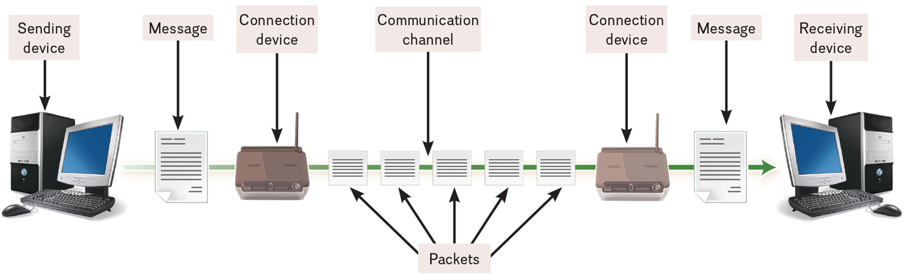
Communication Systems
Electronic systems that transmit data from one location to another.
Figure 8-2
Notes:
Communication systems (key term) are electronic systems that transmit data from one location to another
Communication systems can be wired or wireless

Slide 7
Basic Elements of Communication
Sending and receiving devices.
Computer or a specialized communication device.
Connection devices.
Interface between sending and receiving device.
Data transmission specifications.
Rules and procedures that coordinate the devices.
Communication channel.
Carries the message.
Notes:
Basic elements
Sending and receiving devices (key term) – computer or a specialized communication device
Connection devices (key term) – act as an interface between sending and receiving devices; convert outgoing messages into packets (key term) that can travel across the communication channel
Data transmission specifications (key term) – rules and procedures that coordinate the sending and receiving devices
Communication channel (key term) – carries the message. Can be physical wire or wireless

Slide 8
Communication Channels
Physical Connections using wire or cable.
Wireless Connections.
Notes:
Communication channels carry the data from one computer to another; essential element of every communication system
Two categories of communication channels
Physical Connections using wire or cable
Wireless Connections

Slide 9
Wireless Connections
Wireless connections do not use a solid substance to connect; uses the air itself. Most use radio waves to communicate.
Standard | Maximum Speed
802.11g | 54 mps
802.11n | 600 mps
802.11ac | 2.6 Gbps
802.11ax | 10.5 Gbps
Notes:
Wireless connections do not use a solid substance to connect; uses the air itself. Most use radio waves to communicate

Slide 10
Primary Wireless Technology
Cellular.
Use multiple antennae to communication.
WiMax (extends Wi-Fi).
New standard that uses microwave to extend WiFi.
Bluetooth (short-range).
Radio communication standard.
Satellite.
Uses satellites as microwave relay stations.
Wi-Fi (wireless fidelity).
Uses high frequency radio.
G P S.
Determine geographic location of the devices.
Microwave.
Uses high frequency radio wave signals.
Infrared.
Use infrared light wants to communication over short distances.
Notes:
Types of wireless connections are:
Bluetooth (key term) – short range radio communication standard, 33 ft, wireless headsets, printer connections, hand held devices
WiFi (key term) – wireless Fidelity communicates over short distances. WiFi standards and speeds are shown in the table.
Microwave (key term) - Uses high-frequency radio waves
WiMax (key term) – Worldwide Interoperability for microwave Access – allows greater distances for Wi-Fi.
Cellular (ley term) uses multiple antennae to communicate
Satellite (key term) uses satellites orbiting about 22,000 miles above the earth as microwave relay stations; many of these offered by Intelsat, the International Telecommunications Satellite Consortium which is owned by 114 governments and forms a worldwide communications system
Uplink (key term) sending data to a satellite
Downlink (key term) receiving data from a satellite
GPS (Global Positioning system) (key term) use a network of 24 satellites owned and managed by the Defense Department which continuously sends location information to earth
Infrared (key term)
Light waves used over short distances
Sometimes called line of sight communications
Sending and receiving devices must be in clear view of one another

Slide 11
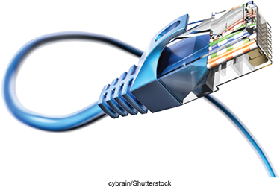

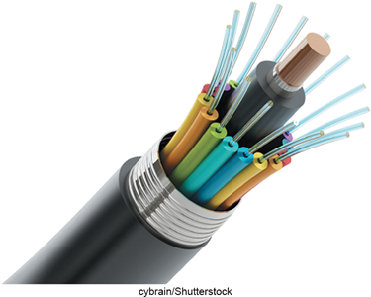
Physical Connections
Physical connection between sending and receiving device include.
Twisted pair cable: two pairs of copper wire twisted together.
Telephone lines.
Ethernet cables.
Coaxial cable: single solid copper core.
Cable TV.
Fiber-optic cable: tiny glass tubes.
Faster and more reliable than coax.
Speeds as high as 1 petabit per second.
Kamolrat/Shutterstock; Flegere/Shutterstock; Hugh Threlfall/Alamy Stock Photo
Notes:
Twisted-pair cable (key term) pairs of copper wire twisted together. Both telephone lines (key term) and Ethernet (key term) are twisted pair.
Ethernet cable (key term) – consists of twisted pair cable; slowest; being phased out by more advanced and reliable media
Coaxial cable (key term) – single solid copper core; 80 times transmission of twisted pair; television and computer networks
Fiber optic (key term) –transmits as pulses of light through tiny tubes of glass. More secure and reliable; best over limited distances; lighter, more reliable, and faster than coaxial cable

Slide 12
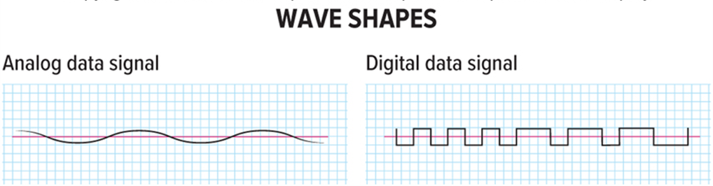
Connection Device Signals
Types of signals.
Analog (telephone).
Digital (computer).
Transfer rates.
Mbps – million bits per second.
Gbps – billion bits per second.
Tbps – trillion bits per second.
Figure 8-9
Notes:
Telephones typically send and receive analog signals (key term) which are continuous electronic waves. Computers, in contrast, send and receive digital signals (key term)
Types of Signals
analog (key term) – telephone signals; continuous electronic wave
digital (key term) – computer signals; presence or absence of an electronic pulse; on/off
Transfer Rate (key term) – the speed in which modems transmit data

Slide 13
Connection Devices
Modem – modulator-demodulator.
Modulation is the process of converting from digital to analog.
Demodulation is the process of converting from analog to digital.
Transfer rate.
Speed in which modems transfer data.
Usually measured in megabits per second (Mbps).
Notes:
Modem (key term) short for modulator-demodulator
Modulation (key term) – convert from digital to analog
Demodulation (key term) - convert from analog to digital
Transfer rate (key term) – rate in Mbps or megabits per second (key term) data transmits

Slide 14
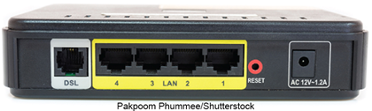

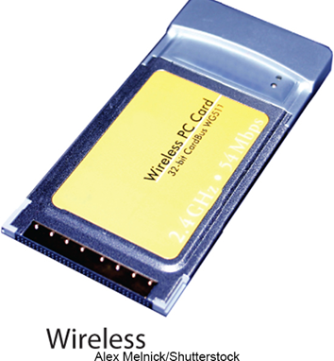
Types of Modems
Digital subscriber line (D S L).
High speed telephone lines.
Cable.
Uses coaxial cable.
Wireless.
Also known as W W A N.
(left): AlexLMX/Getty Images; (middle): iko/Shutterstock; (right): Alex Melnick/Shutterstock
Notes:
Types of modems
DSL (digital subscriber line) (key term) – uses standard phone lines to create a high speed connect.
Cable (key term) - uses same coaxial cable as television
Wireless (key term) – also known as WWAN modem or wireless wide area network (key term)

Slide 15
Connection Services
Leased lines.
T1 combined to form T3 and DS3.
Have been replaced by O C lines.
Faster optical carrier lines.
Cellular service providers.
First Generation 1G, only voice.
Second Generation 2G, used radio signals and introduced texting.
Third Generation 3G, improved data speed, introduced Internet on phones.
Fourth Generation 4G, increased speed, streaming video and music.
Fifth Generation 5G, speeds approaching those of a home Internet connection.
Higher capacity.
Not affordable for individuals.
Notes:
Corporations have been leasing lines for years from telephone companies.
T1 (key term) – copper lines that could be combined to form higher-capacity options such as T3 (key term) or DS3 (key term).
These have been replaced by faster optical carrier (OC) lines (key term).
Cellular service providers
First Generation 1G, only voice
2G used radio signals and introduced textin
3G improved data speed, introduced Internet on phones
4G increased speed, streaming video and music
5G speeds approaching home Internet connection levels

Slide 16
Connection Services - Individual
Digital subscriber line (D S L).
Uses phone lines.
A D S L is most widely used type of D S L.
Fiber Optic Service (FiOS).
New technology.
Google and Verizon.
Satellite connection services.
Use almost anywhere.
Cable.
Uses existing TV cable.
Faster than D S L.
Notes:
Dial-up services (key term) was the original service using existing telephones and telephone modems to connect to the Internet. This type of service has been replaced by higher-speed connection services including DSL, cable, satellite, and cellular services.
Digital subscriber line service - DSL (key term) – uses existing telephone lines to provide high-speed connections; uses DSL modems, ADSL – asymmetric digital subscriber line (key term) is one of the most widely used types of DSL
Cable (key term) – Cable connections using existing cable television cables.
Fiber-optic service – FiOS (key term) – new technology not widely available. Current providers are Google and Verizon
Satellite connection services (key term) – uses satellites to provide wireless connections

Slide 17
Making IT Work for You ~ The Mobile Office
Can telecommute from anywhere.
Become a one-man workforce.
Mobie Hotspot Device.
Personal Hotspot.
Public Wi-Fi.
Cloud Storage.
Videoconferencing.
Notes:
Page 192-193

Slide 18
Factors that Affect Data Transmission
Bandwidth is how much information can move across the communication channel in a given amount of time.
Measurement of the width or capacity of the communication channel.
Categories of bandwidth.
Voiceband (or low bandwidth) – standard telephone.
Medium band – leased lines for high-speed.
Mid-range computer and mainframes.
Broadband for D S L, cable, satellite connections to the Internet.
Baseband for individual connections for computers in close range.
Notes:
Several technical matters affect how data is transmitted. These factors include bandwidth and protocols.
Bandwidth ((key term) – measurement of the width or capacity of the communication channel. It means how much information can move across the communication channel in a given amount of time.
Four Types
Voiceband (key term) – also known as low bandwidth (key term); standard phone line; too slow for many types of transmissions – especially high-quality video; typical speeds are 56 to 96 kbps
Medium band (key term) – with special leased lines to connect minicomputers and mainframes as well as to transmit data over long distances (for larger computer systems); not typically used by individuals
Broadband (key term) – used for high-capacity transmissions (DSL, cable, satellite connections); specialized high-speed devices; effectively transmits high-quality video and other communication needs; typically 1.5 mbps; higher speeds possible
Baseband (key term) – widely used to connect individual computers that are located close to one another

Slide 19
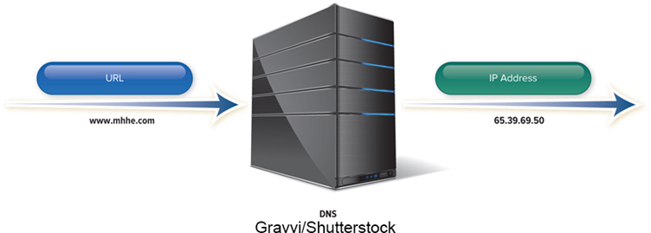
Protocols
Communication rules for exchanging data between computers.
H T T P S – Hypertext Transfer Protocol Secure.
Widely used to protect the transfer of sensitive data.
T C P/I P (Transmission control protocol/Internet protocol).
Each computer is identified with unique I P (Internet Protocol) address.
D N S – Domain name service resolves I P addresses to names.
Packetization – information broken down into small parts (packets) and then reassembled.
Gravvi/Shutterstock
Notes:
Protocols (key term) Rules for exchanging data between computers
HTTPS (key term) – hypertext transfer protocol secure is becoming widely used to protect the transfer of sensitive information
TCP/IP transmission control protocol/Internet protocol (key term) - Internet Standard
Essential features of protocol
Identification - Identifying sending and receiving devices. Every computer on the Internet has a unique numeric address called an IP Address, Internet Protocol address (key term)
Domain Name Server (DNS) (key term) converts text-based addresses to IP addresses
Packetization – allows message to be broken into small parts called packets (key term) so easier to transmit over Internet through various interconnected networks; allows message to be reassembled at destination

Slide 20
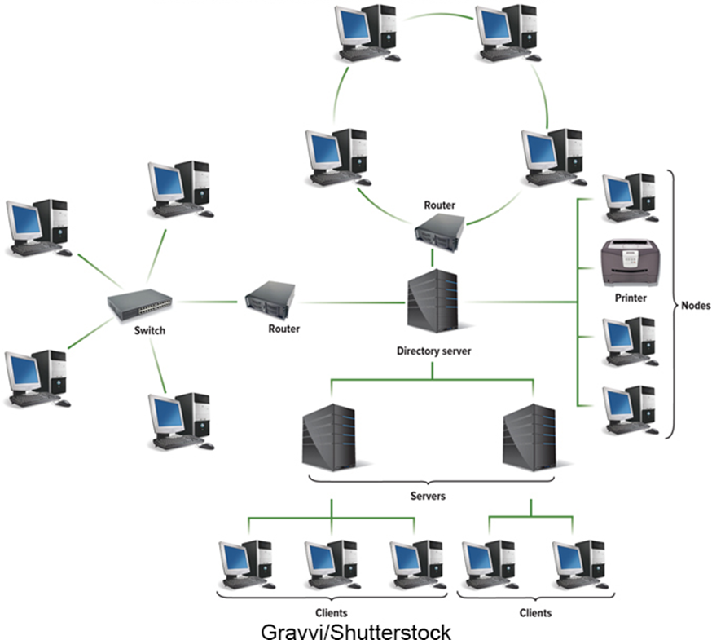
Networks
A communication system that connects two or more computers so they can exchange information and share resources.
Gravvi/Shutterstock
Notes:
A computer network (key term) is a communication system that connects two or more computers so that they can exchange information and share resources
Graphic shows all terms that are defined on the next slide

Slide 21
Network Terminology
Nodes.
Any device connected to a network.
Router.
Node that forwards or routes data packets.
Client.
A node that requests and uses resources from other nodes.
Switch.
Central node that coordinates the flow of data.
Server.
A node that shares resources with other nodes.
Network Interface Cards (N I C).
Expansion card that connects a computer to a network.
Directory Server.
Specialized server that managers resources.
Network Operating System.
Control activities of all computers on the network.
Host.
Computer system that can be accessed over a network.
Network Administrator.
Computer specialists responsible for network operations.
Notes:
Instructor – identify these terms using the graphic –
Nodes (key term) any device connected to a network
Client (key term) a node that requests and uses resources from other nodes
Server (key term) a node that share resources with other nodes
Directory server (key term) – specialized server that manages resources
Host (key term) computer system that can be accessed over a network
Router (key term) node that forwards or routes data packets
Switch (key term) central node that coordinates the flow of data. These tasks used to be performed by a hub (key term)
Network interface cards (NIC) (key term) expansion card that connects a computer to a network
Network operating system (NOS) (key term) control activities of all computers on the network
Network administrator (key term) computer specialists responsible for network operations

Slide 22
Network Types
Type | Description
LAN | Local area network; located within close proximity.
Home | Local area network for home use; typically wireless.
WLAN | Wireless local area network; all communication passes through an access point.
PAN | Personal area network; connects digital devices , such as P D As.
MAN | Metropolitan area network; typically spans cities with coverage up to 100 miles.
WAN | Wide area network for countrywide or worldwide coverage.
Notes:
Communications networks differ in geographical size. Three important types are:
Local area networks - LANs (key term) Computers and devices linked in distances of less than a mile
Linked by cable. Benefits are for economy and flexibility. With network gateways (key term) , LANs can be connected to other LANs or any other type of network. Ethernet (key term) is one standard for connecting network nodes together.
Home Networks (key term) – LANs are now being commonly used by individuals in home/apartments; allow different computers to share resources including a common Internet connection; can be connected by various means including a wireless LAN (WLAN)
Wireless LAN (key term) – wireless local area network
All communications pass through the network’s centrally located wireless access point (key term) or base station (key term)
Hotspot (key term) is a wireless access point that is open to the public
Personal Area networks (key term) – works within a very small area
Connects cell phones to headsets, PDAs to other PDAs, keyboards to cell phones, etc.
MANs (metropolitan area network) (key term) –span distances up to 100 miles
Network linking nodes and resources within the geographical bounds of a city
WANs (wide area networks) (key term) - Countrywide and worldwide networks
Use microwave relays and satellites to reach users
Internet is the widest WAN

Slide 23
Network Architecture
How the network is arranged and how its resources are shared.
Network Topology.
Physical arrangement of the network.
Network Strategy.
How the information and resources are shared.
Notes:
Network topology (key term) is the physical layout.
Network Architecture (key term) describes how a network is arranged and how resources are coordinated and shared

Slide 24
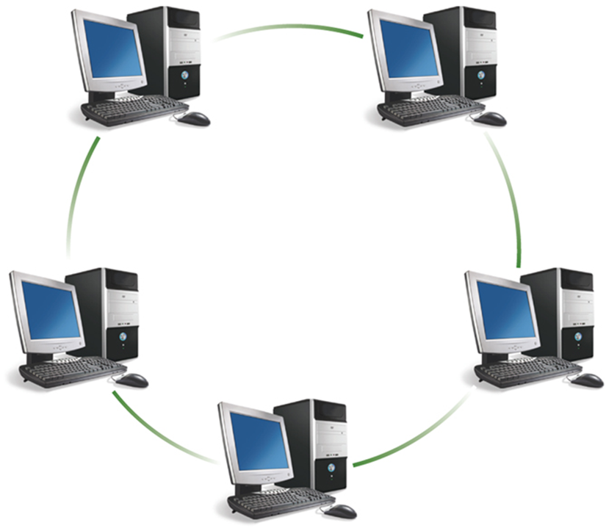
Ring Network
Gravvi/Shutterstock
Notes:
Ring network (Key Term) –Each device is connected to two other devices forming a ring
When a message is sent it passes through each device until it reaches its destination
Bus network (key term) is where each device is connected to a common cable called a bus (key term) or a backbone (key term)

Slide 25
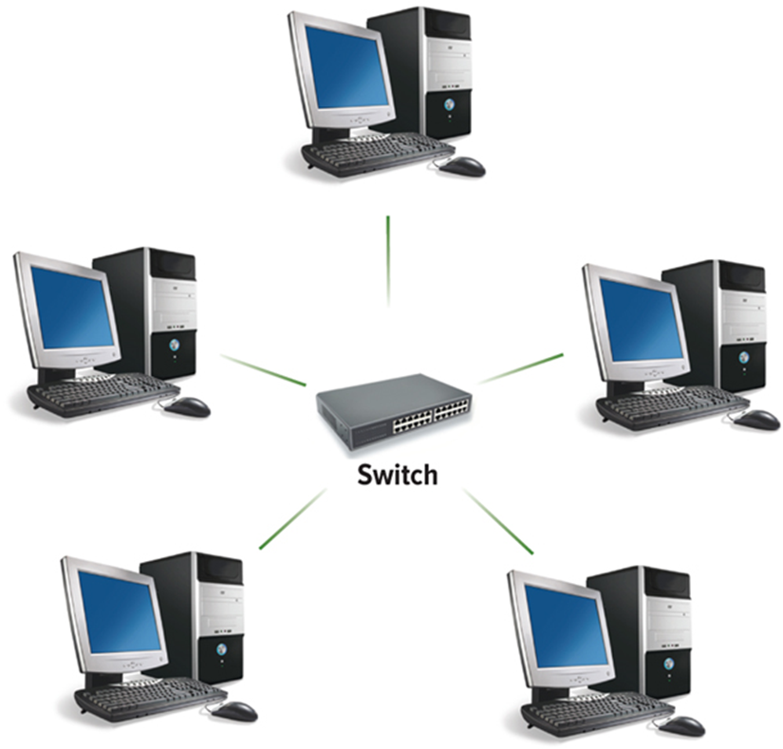
Star Network
Gravvi/Shutterstock
Notes:
Star network (Key Term) – each device is connected directly to a central network switch. Whenever a node sends a message, it is routed to the switch, which then passes the message along to the intended recipient. The star network is the most widely used network topology today.

Slide 26
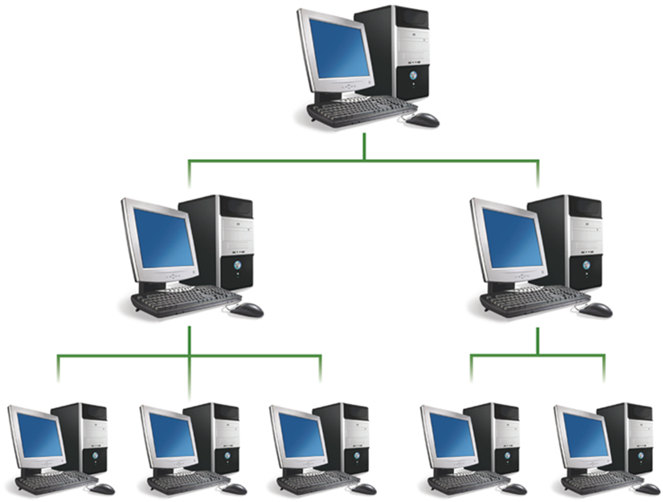
Tree Network
Gravvi/Shutterstock
Notes:
Tree Network (key term)
Sometime called a hierarchical network (key term)
The central node is connected to two or more subordinate nodes that in turn are connected to other subordinate nodes
Useful in centralized organization

Slide 27
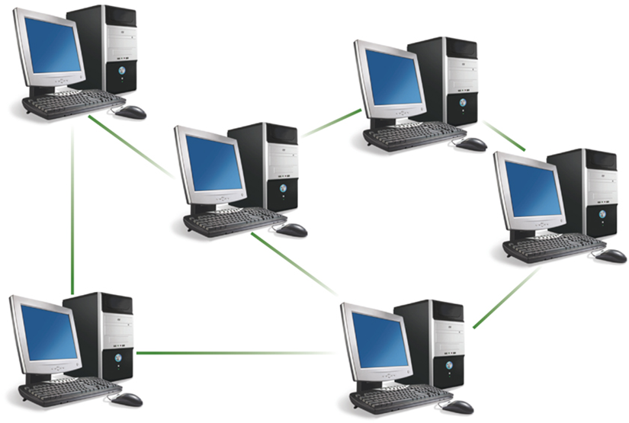
Mesh Network
Gravvi/Shutterstock
Notes:
The mesh network (key term) is the newest type and does not use a specific physical layout. Does not use a specific physical layout, but requires that each node have more than one connection to other nodes . If a path between two nodes is disrupted, data can be rerouted around the failure using another path. Wireless technologies are frequently used to build mesh networks.

Slide 28
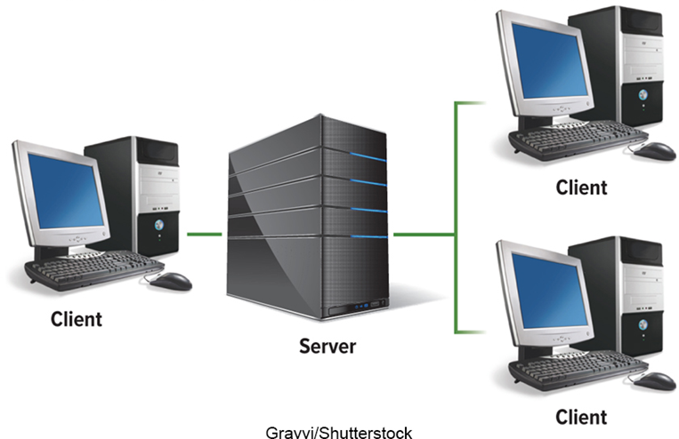
Network Strategies
Client/Server Network.
Central computers coordinate and supply services to other nodes on the network.
Server provides access.
Peer-to-Peer (P2P) Network.
All nodes have equal authority.
Can act as both client and server.
Notes:
Strategy (key term) – way of coordinating the sharing of information and resources. There are two most common types:
Client server network (key term) widely used on the Internet
Advantages:
handle large networks efficiently
availability of powerful network management software to monitor and control network activities
Disadvantages
Cost of installation and maintenance
Commonly used server operating systems:
Windows Server
macOS X Server
Linux
Solaris
Peer-to-Peer (key term) all nodes are equal
BitTorrent – file sharing software
Lack of security

Slide 29
Organizational Networks
Internet technologies support effective communication within and between organizations.
Intranet.
Private network within an organization.
Works like the Internet.
Extranet.
Private network that connects more than one organization.
Works like the Internet, but provides suppliers and other trusted partners with limited access to the organization’s networks.
Notes:
Intranet (key term) private network within an organization
Extranet (key term) private network that connects more than one organization

Slide 30
Network Security
Commonly used technologies to ensure network security.
Firewall.
Hardware and software that controls access to network.
Proxy server provides pass-through access.
Protects against external threats.
Intrusion detection system (I D S).
Works with firewall to protect organization's network.
Analyzes all incoming and outgoing network traffic.
Virtual private network (V P N).
Creates a secure private network connection between your computer and the organization.
Notes:
Firewalls (key term) – Organizational firewalls include a proxy server (key term) all communications between the outside world and an organization must pass through the proxy server where the source and content of each communication is evaluated.
Intrusion detection systems (IDS) (key term)
Uses advanced pattern matching and heuristics
Can recognize signs of a network attack and disable access before an intruder can do damage
Virtual private network (VPN) (key term)
Creates a secure private connection between a remote user and an organizations’ internal network
Creates the equivalent of a dedicated line between a user’s home or laptop computer and a company server

Slide 31
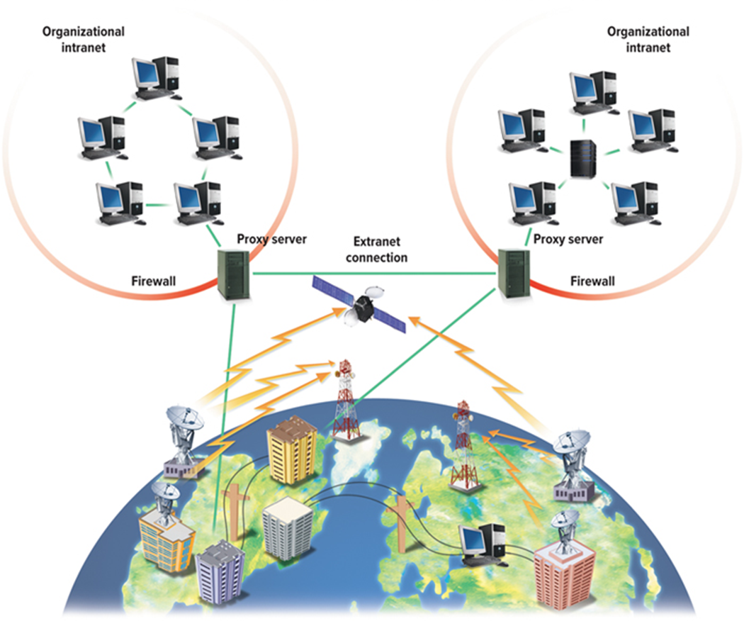
Network Security Graphic
Gravvi/Shutterstock
Notes:
Firewalls (key term) – Organizational firewalls include a proxy server (key term) all communications between the outside world and an organization must pass through the proxy server where the source and content of each communication is evaluated.
Intrusion detection systems (IDS) (key term)
Uses advanced pattern matching and heuristics
Can recognize signs of a network attack and disable access before an intruder can do damage
Virtual private network (VPN) (key term)
Creates a secure private connection between a remote user and an organizations’ internal network
Creates the equivalent of a dedicated line between a user’s home or laptop computer and a company server

Slide 32
Careers in I T
Network Administrator.
Manages a company’s LAN and WAN networks.
Maintains networking hardware and software, diagnosing and repairing problems that arise.
Candidates usually have a bachelor’s or associate’s degree in computer science, computer technology or information systems.
Practical networking experience.
Annual salary is typically between $43,000 and $84,000.
Notes:
Page 203

Slide 33

A Look to the Future
Telepresence.
Seeks to create the illusion that you are actually at a remote location.
Early implementations mainly focus on an extension of video-conferencing.
Egor Kotenko/123RF
Notes:
Review page 204

Slide 34
Open Ended Questions
Define communications including connectivity, the wireless revolution, and communication systems.
Discuss communication channels, including physical connections and wireless connections.
Discuss connection devices including modems (D S L, cable, and wireless modems) and connection services (D S L, A D S L, cable, satellite, and cellular connection services).
Discuss data transmission including bandwidths (voiceband, medium band, broadband, and baseband) as well as protocols (IP addresses, domain name servers, and packetization).
Discuss networks by identifying and defining specialized terms that describe computer networks.
Discuss network types including local area, home, wireless, personal, metropolitan, and wide area networks.
Define network architecture including topologies (bus, ring, star, tree, and mesh) and strategies (client/server and peer-to-peer).
Discuss organization networks including Internet technologies (intranets and extranets) and network security (firewalls, proxy servers, intrusion detection systems, and virtual private networks).
Notes:
Have students turn to the end of Chapter 8 in their textbooks to view the same “Open-Ended” questions/statements

Slide 35
End of Main Content
© McGraw Hill LLC. All rights reserved. No reproduction or distribution without the prior written consent of McGraw Hill LLC.

